Slide 1

DSA
Week 13
Sorting
Data Structures and Algorithms (DSA)
Prescribed Module/Elective
Diploma in CSF, IT
Year 2/3 (2020/21), Semester 4/6

Slide 2
Topics
Introduction to Sorting
Selection Sort
Insertion Sort
Merge Sort
Quick Sort
Radix Sort
Comparison between Sorting algorithms

Slide 3
References
1. Data Abstraction and Problem Solving with C++ 5th Edition
☞ Chapter 9
(Sorting Algorithms & Their Efficiency)

Slide 4
1. Introduction to Sorting
Sorting is a process that organizes a collection of data into either ascending or descending order.
Sort Key is part of the data item that we would consider during sorting.
e.g. sorting VIP customers based on amount spent
sorting hotel room bookings based on prices
sorting popular videos based on number of views
sorting popular movies based on sales
sorting students based on GPA
sorting books of different heights,
sorting records based on record number
sorting sales performance records according sales amount

Slide 5
2. Selection Sort
Strategy
Find the largest item, put in its correct place by swapping
Find the next largest item, put in its correct place, and so on until array is sorted
To put an element in its correct place, it swaps position with that element in that location.
=> the array will have a sorted section that grows from end of array and rest of array remain unsorted.
* can also sort by smallest item

Slide 6










2. Selection Sort
index = 10

Slide 7
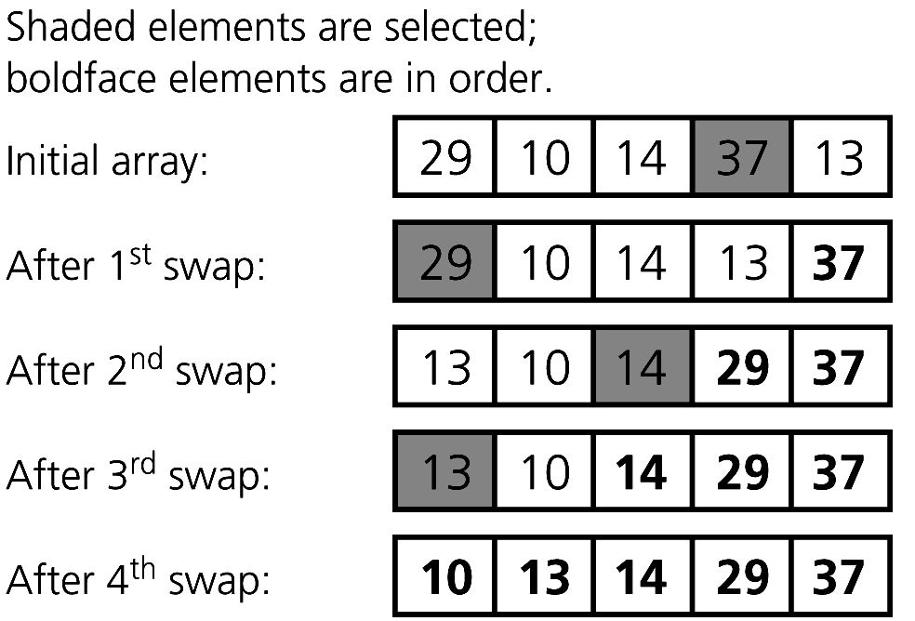
Selection Sort – Example
Copyright © 2007 Pearson Education, Inc. Publishing as Pearson Addison-Wesley. Ver. 5.0.
A selection sort of an array of five integers

Slide 8
Selection Sort- Algorithm
void selectionSort(ItemType array[], int n)
let last be index of the last item in the subarray of items yet to be sorted for (last = n-1; last >= 1; last--) { select largest item in array[0..last] swap largest item with array[last] }

Slide 9
Selection Sort- Implementation
void selectionSort(ItemType array[], int n)
for (int last = n-1; last >= 1; last--) { // select largest item in array[0..last] int largest = indexOfLargest(array, last+1); // swap largest item array[largest] with array[last] swap(array[largest], array[last]); }

Slide 10
Selection Sort- Implementation
int indexOfLargest(ItemType array[], int n)
int largestIndex = 0; // index of largest item for (int i = 1; i < n; i++) { if (array[i] > array[largestIndex]) largestIndex = i; } return largestIndex;

Slide 11
Selection Sort- Implementation
void swap(ItemType& x, ItemType& y)
ItemType temp = x; x = y; y = temp;

Slide 12
Selection Sort – Efficiency Considerations
Analysis
Worst case: O(n²)
-> a loop for finding largest within a loop for selection sort, with number of iterations depending on n
Average case: O(n²)
Does not depend on the initial arrangement of the data
Only appropriate for small n

Slide 13
3. Insertion Sort
Strategy
Partition the array into two regions: sorted and unsorted
Take each item from the unsorted region and insert it into its correct order in the sorted region
(need to shift elements)

Slide 14










3. Insertion Sort
loc = 1

Slide 15
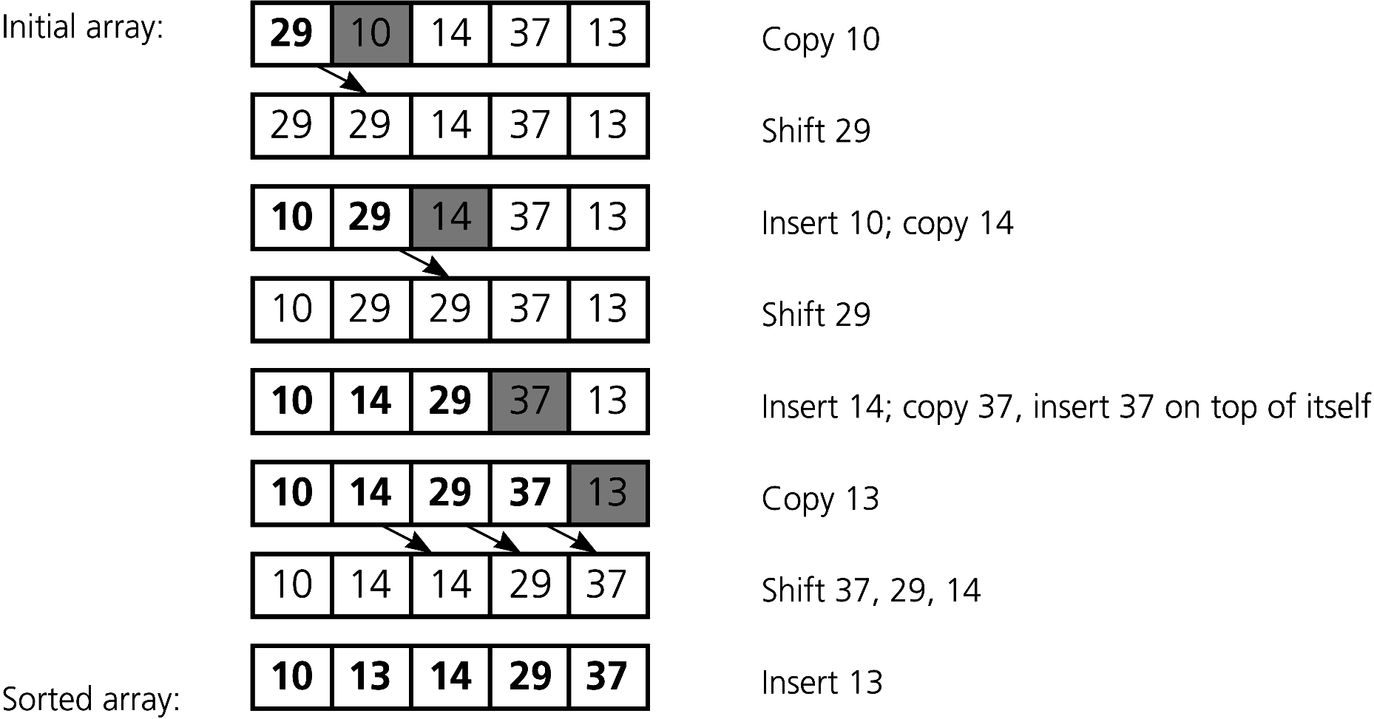
Insertion Sort – Example
Copyright © 2007 Pearson Education, Inc. Publishing as Pearson Addison-Wesley. Ver. 5.0.
An insertion sort of an array of five integers.

Slide 16
Insertion Sort- Algorithm
void insertionSort(ItemType array[], int n)
let unsorted be first index of the unsorted region in general, sorted region is array[0..unsorted-1], unsorted region is array[unsorted..n-1] for (int unsorted = 1; unsorted < n; unsorted++) { let nextItem be first item in unsorted region let loc be index of insertion in the sorted region, find the loc in sorted portion for nextItem; shift, if necessary, to make room }

Slide 17
Insertion Sort- Implementation
void insertionSort(ItemType array[], int n)
for (int i = 1; i < n; i++) // sorted: 0..i-1 unsorted: i..n-1 { // 1. copy data ItemType data = array[i]; // 2. shift larger data to the right int last = i; while ((last > 0) && (array[last - 1] > data)) { array[last] = array[last - 1]; last--; } // 3. insert data array[last] = data; }

Slide 18
Insertion Sort – Efficiency Considerations
Analysis
Worst case: O(n²)
(a loop within a loop with no. of iterations depending on n)
Average case: O(n²)
Best case, when items are already sorted: O(n)
(array[loc-1 ] > nextItem condition is always false)
Appropriate for small arrays due to its simplicity
Prohibitively inefficient for large arrays

Slide 19
Insertion Sort – Efficiency Considerations
Strengths
Good when unordered list is mostly sorted
Need minimum time to verify if list is sorted
Better with pointer-based implementation
(no movement of data)
Weaknesses
Every new insertion requires movements/shifting for some inserted items in ordered portion
When each slot contains large record => movement is expensive
Array-based implementation is less suitable.

Slide 20
4. MergeSort
A recursive sorting algorithm
Strategy
Divide an array into 2 halves
Sort each half
Merge the sorted halves into one sorted array
Divide-and-conquer

Slide 21










4. Merge Sort

Slide 22
MergeSort – Example
Copyright © 2007 Pearson Education, Inc. Publishing as Pearson Addison-Wesley. Ver. 5.0.
A mergesort with an auxiliary temporary array

Slide 23
MergeSort – Example
Copyright © 2007 Pearson Education, Inc. Publishing as Pearson Addison-Wesley. Ver. 5.0.
A mergesort of an array of six integers

Slide 24
MergeSort- Algorithm
void mergesort(ItemType array[], int first, int last)
if (first < last) // more than 1 items { find index of midpoint sort left half array[first..mid] // recursively sort right half array[mid+1..last] // recursively merge the two halves }

Slide 25
MergeSort- Implementation
void mergesort(ItemType array[], int first, int last)
if (first < last) // more than 1 items { int mid = (first + last) / 2; // index of midpoint mergesort(array, first, mid); // sort left half mergesort(array, mid+1, last); // sort right half merge(array, first, mid, last); // merge the two halves }

Slide 26
MergeSort- Implementation
void merge(ItemType array[], int first, int mid, int last)
ItemType tempArray[MAX_SIZE]; // temporary array // initialize the local indexes to indicate the subarrays int first1 = first; // beginning of first subarray int last1 = mid; // end of first subarray int first2 = mid + 1; // beginning of second subarray int last2 = last; // end of second subarray

Slide 27
MergeSort- Implementation
void merge(ItemType array[], int first, int mid, int last)
// while both subarrays are not empty, copy the // smaller item into the temporary array int index = first1; // next available location in tempArray for (; (first1 <= last1) && (first2 <= last2); index++) { if (array[first1] < array[first2]) { tempArray[index] = array[first1]; first1++; } else { tempArray[index] = array[first2]; first2++; } }

Slide 28
MergeSort- Implementation
void merge(ItemType array[], int first, int mid, int last)
// finish off the nonempty subarray // finish off the first subarray, if necessary for (; first1 <= last1; ++first1, index++) tempArray[index] = array[first1]; // finish off the second subarray, if necessary for (; first2 <= last2; ++first2, index++) tempArray[index] = array[first2]; // copy the result back into the original array for (index = first; index <= last; index++) array[index] = tempArray[index]; }

Slide 29
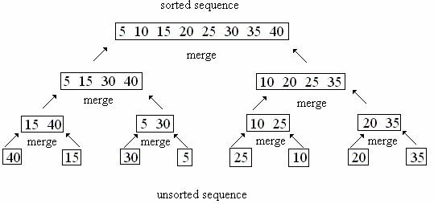
MergeSort – Efficiency Considerations
Analysis
Performance is independent of initial order of the array items
Worst case : O(n log₂ n)
Average case: O(n log₂ n)
-> log₂ n levels of recursive calls
-> n key comparisons made at each level

Slide 30
MergeSort – Efficiency Considerations
Strengths
an extremely fast algorithm, good runtime behaviour
implements easily when using pointer-based implementation
Weaknesses
for array implementation, need auxillary storage
(which requires data movements again during merging)
-> difficult to implement for array implementation

Slide 31
5. Quick Sort
Fastest general purpose in-memory sorting algorithm in the average case
Strategy
A divide-and-conquer algorithm
Partition the array into 2 partitions about the pivot
Choose an element as pivot (can be any element!)
Elements in each part are rearranged such that
items < pivot on left of pivot (left partition)
items >= pivot on right of pivot (right partition)
Recursively partition the left and right partitions
(until the partition has less than 2 elements)

Slide 32













5. Quick Sort

Slide 33
QuickSort- Algorithm
void quicksort(ItemType array[], int left, int right)
if (first < last) // more than 1 items { create the partition: S1, pivot, S2 sort partition S1 // recursively sort partition S2 // recursively }

Slide 34
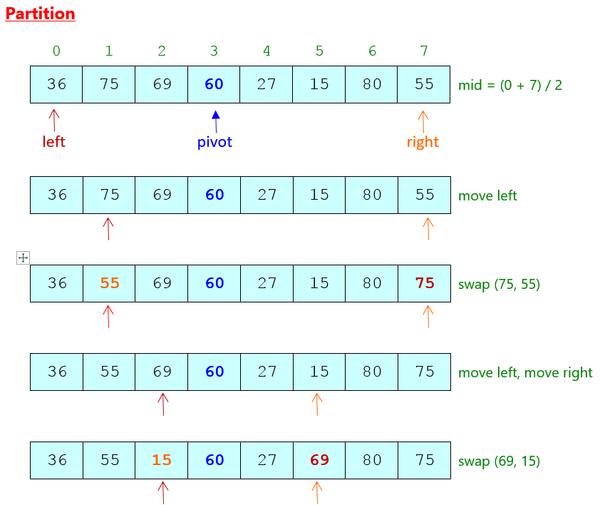
Quick Sort – Example 1
Pivot is middle element

Slide 35
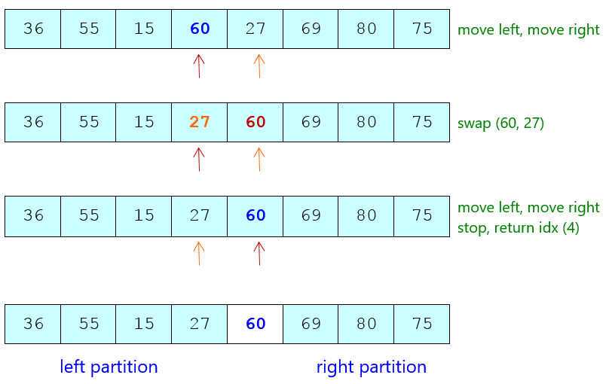
Quick Sort – Example 1

Slide 36
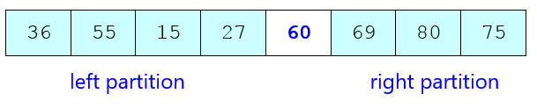
Quick Sort – Example 1
Partition
Call quicksort to sort :
left partition recursively
right partition recursively

Slide 37
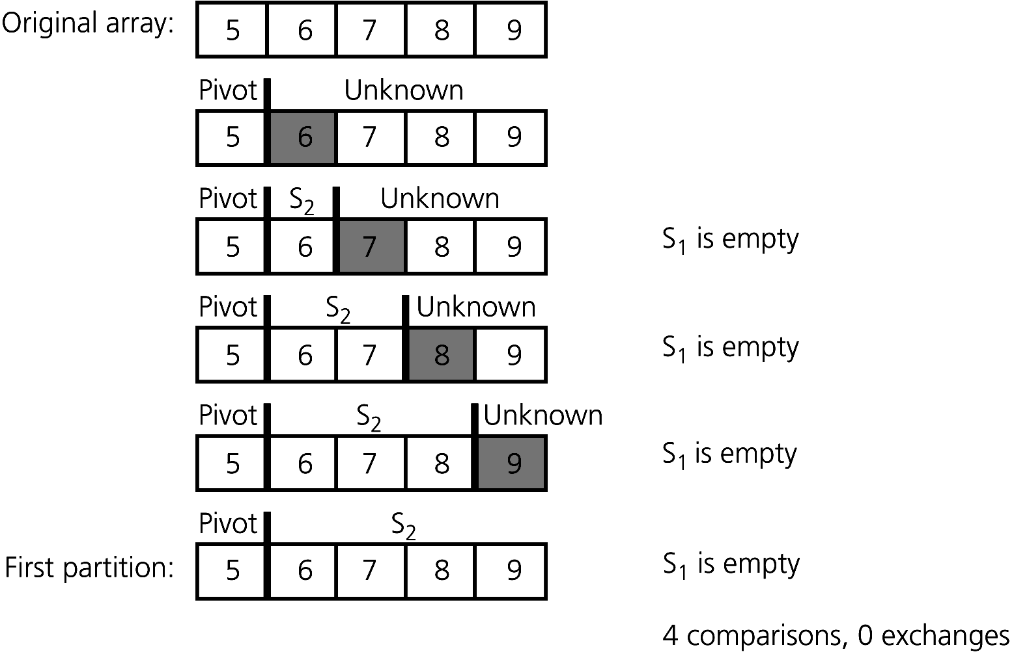
Quick Sort – Example 2
Pivot is first element
A worst-case partitioning with QuickSort

Slide 38
QuickSort- Implementation
void quicksort(ItemType array[], int left, int right)
if (left < right) // stop when there are less than 2 elements { int pivotIdx = partition(array, left, right); quicksort(array, left, pivotIdx-1); // sort left partition quicksort(array, pivotIdx+1, right); // sort right partition }

Slide 39
QuickSort- Implementation
int partition(ItemType array[], int left, int right)
int pivot = array[(left+right) / 2]; // can be any element! while (left < right) // stop when there are less than 2 elements { while (array[left] < pivot) // move left index left++; while (array[right] > pivot) // move right index right--; if (left < right) // swap the elements { ItemType temp = array[left]; array[left] = array[right]; array[right] = temp; } } return left; // return the pivot index

Slide 40
QuickSort – Efficiency Considerations
Analysis
Average case: O(n log₂ n)
-> log₂ n levels of recursive calls
-> n key comparisons made at each level)
Best case: O(n log₂ n)
-> when pivot always splits array into equal halves
Worst case: O(n²)
-> When at each recursive call, the smallest or biggest item is chosen as the pivot

Slide 41
QuickSort – Efficiency Considerations
Strengths
Fast on average
No merging required
Best case if pivot always splits data into equal halves
Weaknesses
Pivot need to be chosen carefully
Quicksort performs badly when the array is already sorted and pivot is largest or smallest element
Performs badly when n is small
(due to overhead in recursive calls)

Slide 42
Radix Sort
Strategy
Treats each data element as a character string
Repeatedly organizes the data into groups according to the i^{th} character/digit in each element

Slide 43
Radix Sort – Example

Slide 44
Radix Sort- Algorithm
void Radixsort(ItemType array[], int n, int digit)
for(j = digit down to 1) { initialize 10 groups to empty initialize a counter for each group to 0 for (i = 0 through n-1) { k = jth digit of array[i] place array[i] at the end of group k increase kth counter by 1 } replace the items in theArray with all the items in group 0, followed by group 1 and so on. }

Slide 45
Radix Sort – Efficiency Considerations
Analysis
Distributing the elements according to value of digit : O(n)
(n is the number of iterations)
Combining the elements at the last step : O(n)
Involves distributing and combining for no of times equal to no of digits (which is a constant, not dependent on n)
=> Overall complexity is O(n)
key is treated as string and must have the same length
(restrictive, not universal)

Slide 46
Comparison of Sorting Algorithms
Time Complexity | Worse Case | Average Case
Selection Sort | O(n²) | O(n²)
Insertion Sort | O(n²) | O(n²)
Merge Sort | O(n log₂ n) | O(n log₂ n)
Quick Sort | O( n²) | O(n log₂ n)
Radix Sort | O(n) | O(n)
Tree Sort | O(n²) | O(n log₂ n)
Approximate growth rates of time required

Slide 47
Summary
Introduction to Sorting
Selection Sort
Insertion Sort
Merge Sort
Quick Sort
Radix Sort
Comparison between Sorting algorithms

